Slide 1
PROJECT REVIEW – 2
Explainable Machine Learning Framework for Early Heart Disease Prediction
Group – 8
2420030503 – Katta Anoop
2420030490 – V. Sree
2420030582 – Sameera M
2420030537 – Souraja M
Under the guidance of
Dr.K.Swanthana
1

Slide 2
PROJECT OVERVIEW
• Predict early heart-disease risk using Machine Learning
• Preprocess healthcare data
• Build an Ensemble ML model using multiple learners
• Use SHAP and LIME for patient-level explanations
• Support transparent clinical decision-making
2

Slide 3
METHODOLOGY
1. Dataset Collection → Public heart-disease dataset
2. Preprocessing → Cleaning • Encoding • Scaling • Class balancing
3. Base Models → Multiple ML classifiers
4. Ensemble Learning → Combine model predictions
5. Evaluation → Accuracy • Precision • Recall • F1 • ROC-AUC
6. Explainability → SHAP + LIME
3

Slide 4
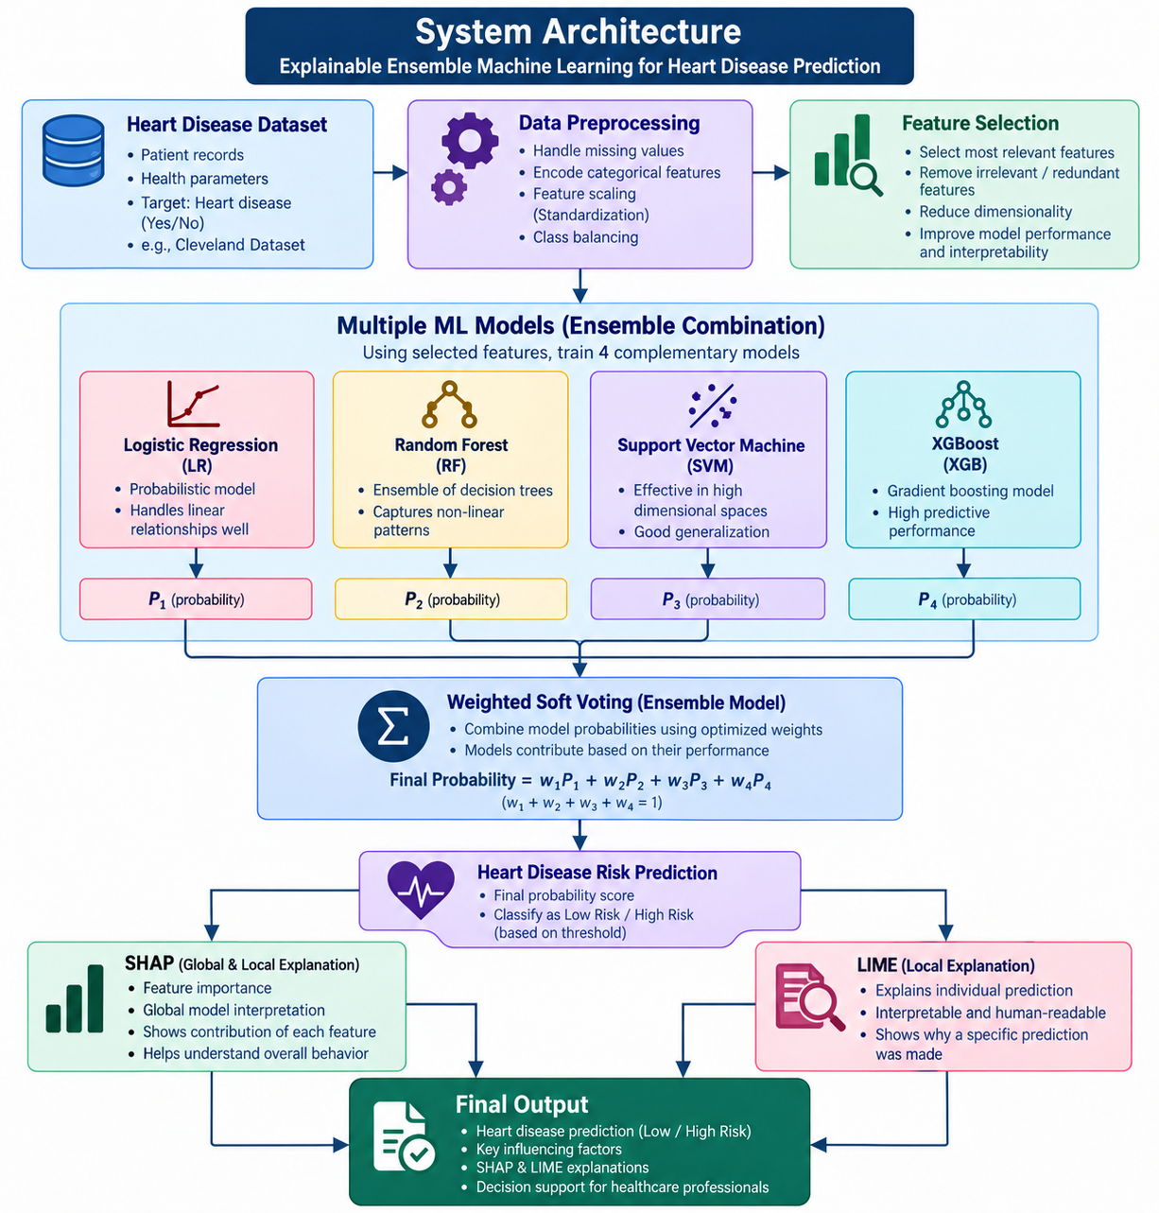
SYSTEM DESIGN
HEART-DISEASE DATA
↓
DATA PREPROCESSING
Cleaning → Encoding → Scaling → Balancing
↓
BASE ML MODELS
Multiple classifiers
↓
ENSEMBLE MODEL
Combined prediction
↓
SHAP + LIME
↓
RISK PREDICTION + EXPLANATION
↓
DECISION SUPPORT DASHBOARD
4

Slide 5
MODERN TOOLS & TECHNOLOGIES
• Python – Main programming language
• Pandas – Data handling
• NumPy – Numerical operations
• Scikit-learn – ML algorithms & evaluation
• Ensemble Learning – Combines multiple model outputs
• SHAP – Feature contribution explanations
• LIME – Local prediction explanations
• Matplotlib – Visualization
• Google Colab / Jupyter – Development
5

Slide 6
IMPLEMENTATION
• Load heart-disease dataset
• Handle missing/inconsistent values
• Encode categorical attributes
• Scale numerical features
• Train multiple base classifiers
• Combine predictions using Ensemble Learning
• Evaluate the ensemble model
• Generate SHAP and LIME explanations
• Display prediction with important factors
6

Slide 7
EXPLAINABLE AI IMPLEMENTATION
ENSEMBLE MODEL
• Combines predictions from multiple ML models
• Aims to improve robustness and prediction reliability
SHAP
• Shows how features contribute to the prediction
LIME
• Explains an individual prediction locally
OUTPUT → Ensemble Prediction + Patient-Specific Explanation
7

Slide 8
RESULTS & EVALUATION
• Accuracy – Overall correct predictions
• Precision – Correct positive predictions
• Recall – Correctly detected positive cases
• F1-Score – Balance of precision and recall
• ROC-AUC – Class separation ability
• Confusion Matrix – TP, TN, FP, FN
• Add final numerical results after actual model testing
8

Slide 9
PREDICTION DASHBOARD
• Enter patient health parameters
• Process the input
• Ensemble model predicts heart-disease risk
• SHAP shows important feature contributions
• LIME provides a local explanation
• Present prediction and explanation clearly
• Add screenshot of the implemented dashboard
9

Slide 10
Proposed Model
PROPOSED MODEL: WEIGHTED SOFT-VOTING ENSEMBLE
Baseline Models
Logistic Regression
Random Forest
SVM
XGBoost
Decision Tree
Our Proposed Approach
Feature Selection + Weighted Soft Voting
Ensemble Combination:
Logistic Regression + Random Forest + SVM + XGBoost
How our model works
Dataset → Preprocessing → Feature Selection → 4 ML Models → Weighted Probability Voting → Final Prediction → SHAP + LIME

Slide 11
What is different?
Instead of depending on one classifier, we combine 4 complementary models.
Feature selection focuses the models on important clinical features.
Weighted voting gives more influence to stronger model predictions.
SHAP + LIME explain the final patient-level prediction.
Important: Decision Tree remains a baseline model, but it is not part of our final ensemble.
Why our model performs better
Accuracy: +0.80 percentage points vs best baseline
Precision: +0.42 points
Recall: +0.24 points
F1: +0.86 points
ROC-AUC: +0.24 points

Slide 12
RESEARCH PAPER DRAFT PREPARATION
• Title – Explainable Ensemble ML Framework for Early Heart Disease Prediction
• Abstract – Problem, approach and contribution
• Introduction – Heart disease + ML + need for XAI
• Literature Survey – Existing ML, ensemble and XAI approaches
• Methodology – Preprocessing, base models, ensemble, SHAP & LIME
• Results – Evaluation metrics and model comparison
• Conclusion – Prediction + transparency
• References – Research papers and dataset sources
10

Slide 13
CONCLUSION & FUTURE SCOPE
CONCLUSION
• Combines multiple ML models through Ensemble Learning
• Provides patient-specific explanations using SHAP and LIME
• Improves transparency and interpretability
• Supports informed clinical decision-making
FUTURE SCOPE
• Test on larger and diverse datasets
• Improve dashboard and visualization
• Perform stronger clinical validation
• Explore additional ensemble and XAI techniques
11

